Slide 1

Supermarket Sales Analysis
Group 8
Chetan Bandi
Soundarya Bachu
Swati kolpekwar
Vishaka Sharma

Slide 2
Introduction & Overview
Purpose: Visualizing the Supermarket sales-data is important to understand the customer-satisfaction level which can impact the profit of the organizations drastically and can help in the development of the marketing strategies that can influence the purchasing behavior of different customer classes.
Dataset: 1000 observations capturing key metrics like Unit_price, Quantity, Total, Cogs, and gross_income.
Training set: 80%
Test set: 20%
Variables: Customer_type,Gender ,Product_line, Unit_price, Quantity, Tax, Total, Date, Time, Payment, cogs, gross_income, Rating
Rating Categorization: Rating classified into Low and High satisfaction levels to identify purchase patterns and build predictive models.
Includes quantitative (e.g., gross_income) and categorical (e.g., customer_type, gender) data.
Goal: Understand and predict factors influencing customer satisfaction, as reflected in the rating provided by customers. By categorizing ratings into two classes (e.g., High and low satisfaction) .
Data source: https://www.kaggle.com/code/aryantiwari123/supermarket-sales-prediction/input

Slide 3
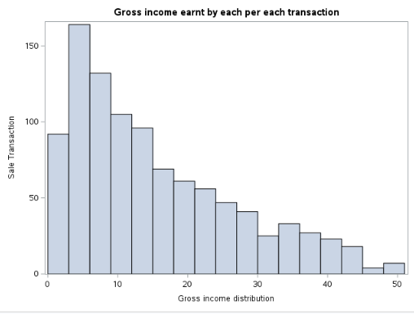
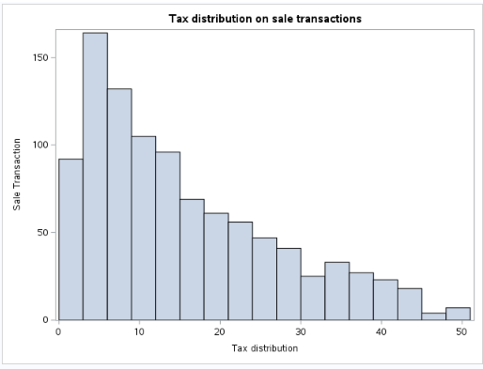
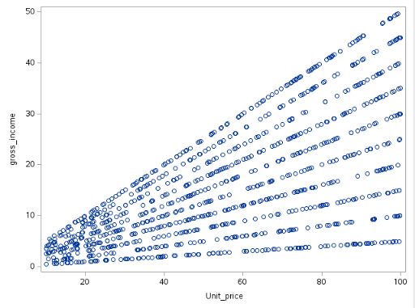
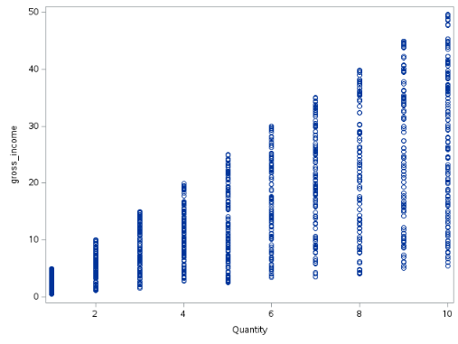
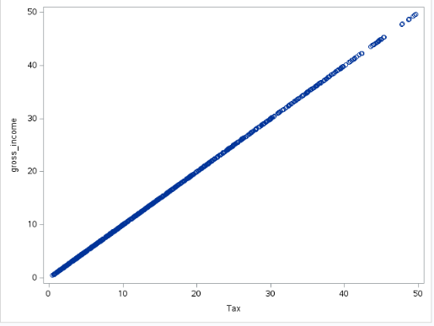
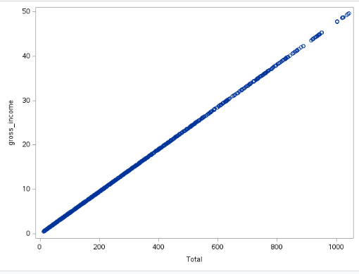
Plots
The gross-income histogram is right-skewed and also significant number of sale transactions generate income between the range of 0-10 and the transactions generating income between the range of 40-50 is very low.
The Tax distribution histogram is right-skewed and also most of the tax collected on the sales transaction is between 0-10 and the tax collected 40 on the transactions is merely low.
The scatter plots exhibit positive linear relationship between Gross_income and Unit_price, Tax, Quantity and Total, as expected. Increased Gross_income correlates with higher Unit_price, Tax, Quantity, and Total.

Slide 4
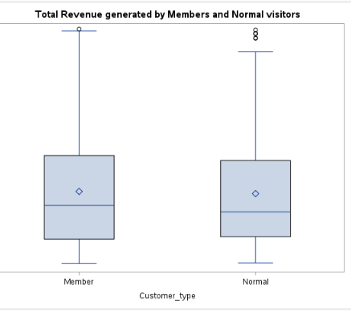
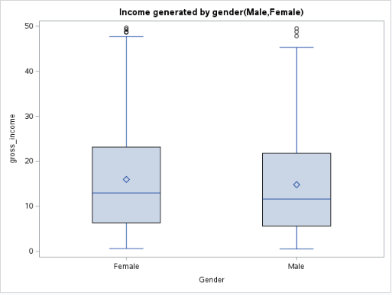
Plots
The revenue generated by the Members is high compared to Normal customers with the median value being slightly high . Also the mean total being high for members compared to normal visitors. The member and normal customers exhibit positive skewness with the total top whisker being high. But comparatively Normal customers have more outliers than members.
When looking at IQR & Variability, members demonstrates greater variability, which reflects more spending among its customers.
The median and mean value of females is slightly high compared to the median and mean value of males which slightly generates high income compared to males. Both the whiskers are right skewed with female whisker being slightly high. Both the categories also demonstrate very similar IQR & Variability.

Slide 5
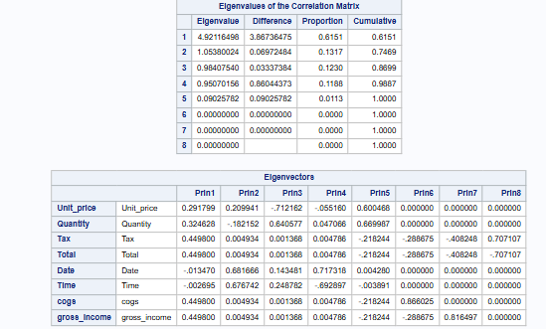
Principal Component Analysis
Looking at the above PCA analysis Correlation would be better as the variables are measured in different units.
Looking at the Eigenvalues the first principal component accounts 61% of the data variability and the second Principal component accounts for 13% of the data variability and 86% of the variability is explained in the first three principal components only.
Looking at the most important features in each Principal component:
Prin1- Tax, Total, Cogs and Gross_income
Prin2 – Date and Time
Prin3 – Quantity
Prin4 – Date and Time
Prin5 – Quantity
Prin6 - Cogs
Prin7 – Gross_income
Prin8 – Total and Tax

Slide 6
Models
Logistic Regression
CART
Neural Networks
Discriminant Analysis

Slide 7
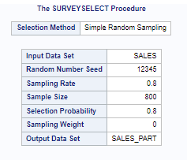
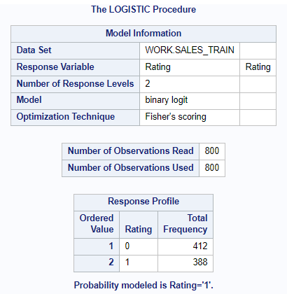
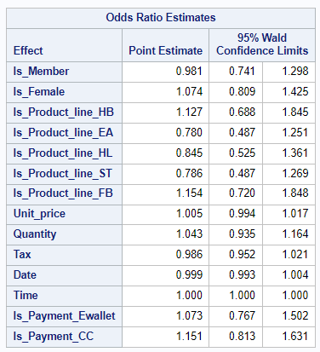
Logistic Regression
Odds Ratio Estimate for Is_Member is 0.981, The odds of having rating one is 2% lower if the customer is member of the supermarket.
Odds Ratio Estimate for Is_Product_Line_HB is 1.127, The odds of having rating one is 12.7% higher for health and beauty compared to the default Fashion accessories product line.

Slide 8
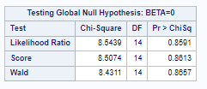
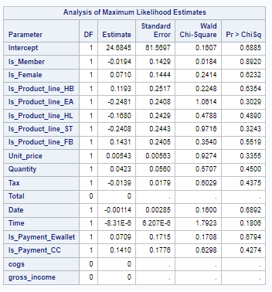
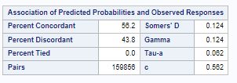
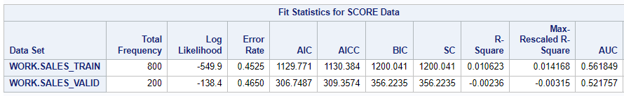
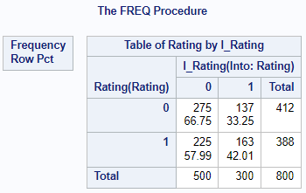
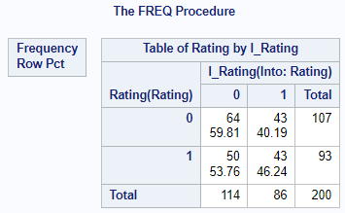
Logistic Regression
The model is statistically not significant.
All the variables are not significant.
AUC is acceptable.
 | Training |  |  |  | Validation
 | AUC | Error Rate | Sensitivity | Specificity | AUC | Error Rate | Sensitivity | Specificity
Logistic Regression Model | 0.56 | 45% | 42% | 67% | 0.52 | 46% | 46% | 60%
Logistic Regression Model - Final | 0.56 | 45% | 42% | 67% | 0.52 | 46% | 46% | 60%

Slide 9
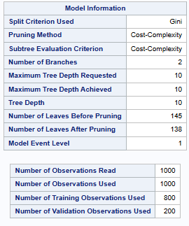
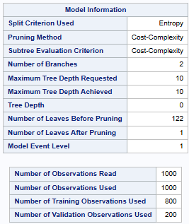
CART
Gini Model: Complex with 138 leaves, captures more patterns but has high validation error, showing poor generalization.
Entropy Model: Too simple with 1 leaf, lacks complexity to capture meaningful patterns in the data.

Slide 10
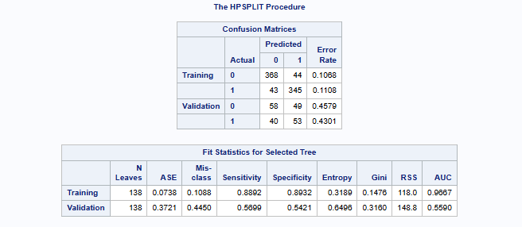
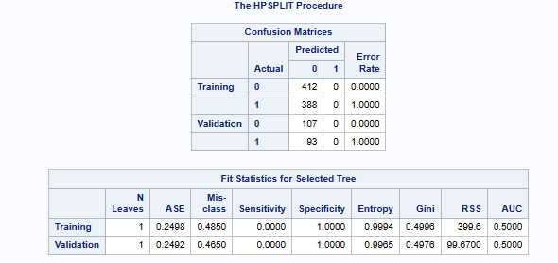
CART Model: Gini vs. Entropy
Gini Model
Training Data:
  Lower misclassification rates
  Higher sensitivity and specificity
  Performs well on training data
Validation Data:
  Struggles with generalization, indicating potential overfitting
Entropy Model
High misclassification rates for both training and validation data
Poor handling of class imbalances
Training and validation AUC values near 0.5 shows poor predictive performance.
Conclusion
The Gini model performs better overall, offering balanced metrics compared to the entropy model.

Slide 11
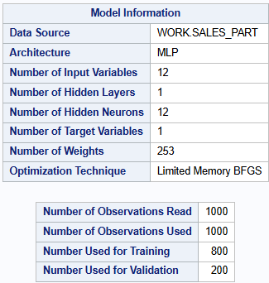
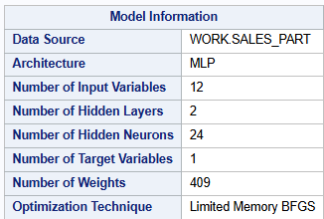


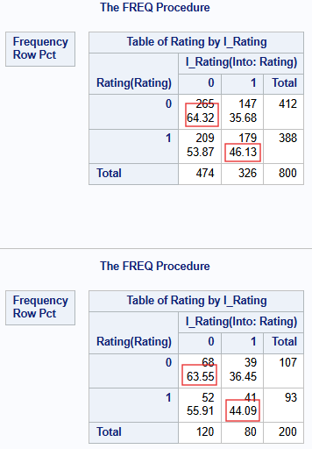
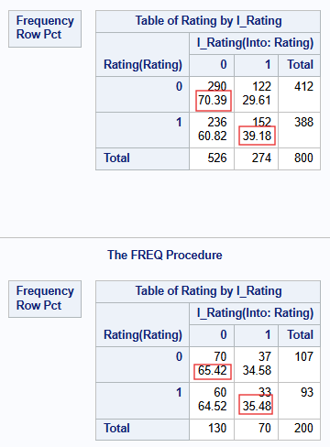
Neural Networks
The misclassification rate is lower for both sets.
The sensitivity is approx. 46% on training and 44% on validation set, suggesting that there is room for improvement in identifying true positives.
The specificity is approx. 64% for both sets.
The model with 1 hidden layer of 12 neurons shows a moderate performance with no overfitting.
Adding another hidden layer – 12 neurons did not make much difference.

Slide 12


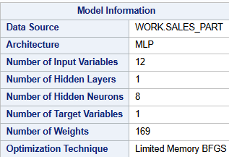
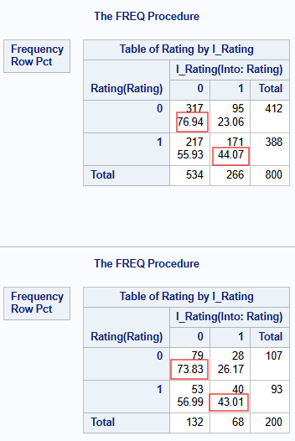
Reducing the neurons to 8
The misclassification rate was reduced to 0.39 and 0.40 for the training & Validation set.
Sensitivity remains at same levels for training & validation.
Specificity improved for validation to 74%.
There is still room for improvement in sensitivity, but overall the model performed better with no sign of overfitting.
Notes:
The misclassification rate for training set reduced to 34.90% and validation set reduced to 38.10%.
The sensitivity is 21.76% for training and 12.20% for validation set.
The specificity is 93.27& for training set and 93.75% for validation set.

Slide 13
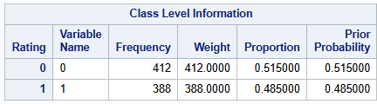
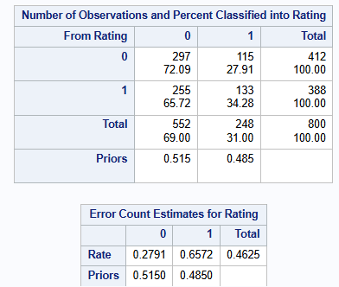
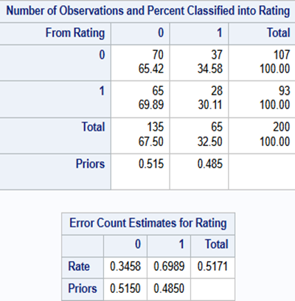
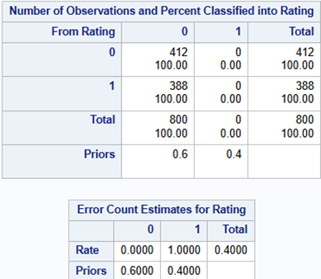
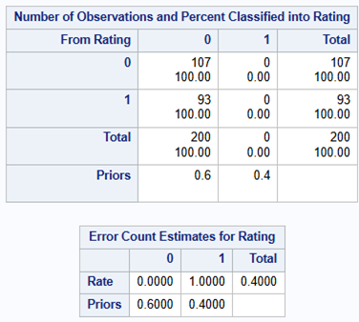
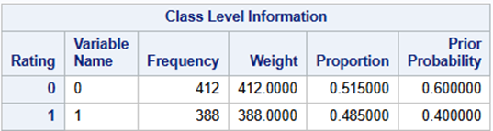
Discriminant Analysis
412 observations (52%) belong to Class 0 (unsatisfactory ratings).
388 observations (48%) belong to Class 1 (satisfactory ratings).
Sensitivity: The model struggled to identify true positives effectively.
Specificity: Achieved moderate accuracy in identifying true negatives.
Prior Proportion of 60-40
Model couldn’t identify true positives.

Slide 14
Conclusion
 | Training |  |  |  | Validation
 | AUC | Error Rate | Sensitivity | Specificity | AUC | Error Rate | Sensitivity | Specificity
Logistic Regression Model | 0.56 | 45% | 42% | 67% | 0.52 | 46% | 46% | 60%
CART Model (Gini) | 0.97 | 10% | 89% | 89% | 0.56 | 44% | 57% | 54%
Neural Network (hidden layer 8) |  | 39% | 44% | 77% |  | 41% | 43% | 74%
Discriminant Analysis |  | 46% | 34% | 72% |  | 51% | 30% | 65%
Model Comparison:
The CART model performs well on the training with 89% sensitivity and specificity, but weaker error metrics on the validation set shows signs of overfitting.
Neural Network Analysis: Outperforms other models on the validation set, with the highest sensitivity (43%) and specificity (74%), coupled with a relatively low error rate of 41%. This indicates its strong generalization ability, making it the most suitable model for predicting customer satisfaction.

Slide 15
Findings:
Key factors influencing customer satisfaction through data-driven analysis - Total price, Date and Time.
Models can predict satisfaction trends across similar customer demographics
Shortcomings:
Potential biases in the data collection process could impact the generalizability of results.
The dataset size is relatively small, which might limit the robustness of the findings.
Suggestions for Improvement:
Increase the dataset size(2019) and diversity to capture a wider range of customer behaviors.
Incorporate additional variables, such as customer feedback, to improve the accuracy and relevance of predictions.

